Slide 1


SMART IRRIGATION
Under guidance of Mr. S.Tamilselvan Assistant Professor BIT
Sathy.
(7376211CS248
&PRAVEENRAJA.SK)
(7376211IT146 & HARIPRASAD.S) (7376211CS231 & NIKILANAND.S) (7376211CS166 & INDHUJA.J)

Slide 2
Abstract
The concept of this project is to allow the owners of fields to control and observe the growth of their plants in their farms. This is achieved by using a smart platform of IoT and solenoid valves to control the flow of water based on the moisture of the soil and gives real time surveillance to the owners who stay far away from the farms. This project also allows surveillance on the personnel and their crops so as to not occur losses. It is easy to use for anyone with a Smartphone and doesn’t require maintenance once set up.

Slide 3
Problem Statement Addressed
The expansion and intensification of agriculture made possible by irrigation has the potential for causing: increased erosion; pollution of surface water and groundwater from agricultural biocides; deterioration of water quality; increased nutrient levels in the irrigation and drainage water resulting in algal blooms, ...

Slide 4
Existing Solution to the Problem Addressed
Smart irrigation technology is set to fix these problems through the use of IoT-powered agricultural sensors that enable farmers to closely monitor field conditions and adjust irrigation practices accordingly. This results not only in more efficient water management but in higher crop yields and lower costs.

Slide 5
Proposed Solution to the Problem Addressed
This project has been designed for surveillance of irrigation systems in farms without the need of manual checking of irrigation systems. For example, if you are staying in Bangalore, and have your farm in Andhra Pradesh or elsewhere and it is not possible for you to go to the farms every time to keep a tab on the plants. Instead, this project allows you to check up on your plants using a simple IoT system. The positive part of this project is that, the node used to connect the system to your smart device, also controls the flow of water from the pump and also the timing intervals in between the irrigation cycles. In this paper we will be discussing all about the project as to how it is constructed and how it works.

Slide 6
Project Work Plan
In this project, the soil moisture sensors are placed at every few feet with the probes in the ground. The soil moisture sensor is set to a particular level based on the type of soil and the crops being grown. This project is useful for cropsthat need constant irrigation in small amounts of water. Every 4 hours, the soil moisture is checked through the sensor. The sensors value is then sent to the NodeMCU or the WiFi module. Since this acts like an arduino but can be connected to the WiFi, the sensor reading are checked and matched to the set value of reading. If the value of the soil moisture sensor is equal to the set value, then a command is sent to the solenoid valve to close. A message is then sent to the client’s mobile or app which is connected to theNodeMCU saying that the plants haven’t been watered because the soil moisture level is already equal to the set value. The solenoid valve is generally closed. The moisture is then checked after 4 hours. If the moisture of the soil is less, then the NodeMCU sends a command to the solenoid valve to open. When the solenoid valve is opened, the drip irrigation system starts to drip the water at the roots. It allows water for half an hour and after half an hour; the moisture level is again checked and sent to the NodeMCU. A message is sent to the client device saying that the plants have been watered at that particular time. The process then repeats all over. The intention of this project is to provide the clients far away from the fields, a chance to keep an eye on their plants.

Slide 7
Project Work Plan
Once the solenoid valve is open, the back wash valve is closed, the pressure gauge starts fluctuating as the pressure is built up to pump the water. Once the particular pressure is obtained, the by-pass valve opens and pump gets switched on. The pump then pumps out water from the well and the water flows through the main line and the sub-lines and the water is delivered to the roots of the out water from the well and the water flows through the main line and the sub-lines and the water is delivered to the roots of the plant, drop by drop. When the solenoid valve closes, all these processes are shut off hence shutting off the water supply to the plants.

Slide 8
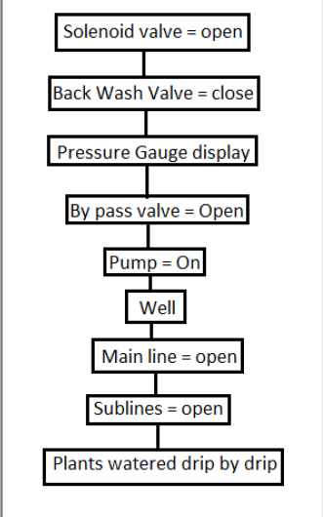
Project Work Plan

Slide 9
Project Work Plan
Steps:
*Install required libraries
*First refer Getting Started with NodeMCU using Arduino IDE if you are not installed NodeMCU board packages in Arduino IDE.
*Here we are using Adafruit libraries for above example. We will need to install the Adafruit IO, Adafruit MQTT, and Arduino Http Client libraries using the Arduino Library Manager.
*Open the Arduino IDE and navigate to Sketch -> Include Library -> Manage Libraries…
*Library Manager Window will pop up. Now enter Adafruit IO Arduino into the search box, and click Install on the Adafruit IO Arduino library option to install version 2.6.0 or higher.
*Now enter Adafruit MQTT into the search box, and click Install on the Adafruit MQTT libraryoption to install version 0.17.0 or higher.
*Now enter Arduino Http Client into the search box, and click Install on the ArduinoHttpClientlibrary option to install version
0.3.0 or higher.
*Now open example of Adafruit mqtt Io dashboard. To open it navigate to File -> Examples -> Adafruit MQTT Library ->mqtt_esp8266
*Now edit the Wifi and Adafruit Io credentials with correct information

Slide 10
Project Work Plan
Arduino Sketch for Solenoid Valve
#include "CayenneDefines.h"
#include "CayenneWiFi.h" #include "CayenneWiFiClient.h"
#define CAYENNE_PRINT Serial // Comment this out to disable prints and save space
#define RELAY_PIN 14 // RELAY PIN const int sensorPin= A0;
//sensor pin connected to analog pin A0 float liquid_level;
int liquid_percentage; int top_level = 512;
int bottom_level = 3; // Cayenne authentication token. This should be obtained from the Cayenne Dashboard. char token[] = ""; // Insert your token here char ssid[] = ""; // Insert your SSID here char pwd[] = ""; // Insert your SSID password here void setup() { Serial.begin(115200); Cayenne.begin(token, ssid, pwd); pinMode(sensorPin, INPUT); pinMode(RELAY_PIN, OUTPUT); } void loop() { liquid_level = analogRead(sensorPin); liquid_percentage = ((liquid_level-bottom_level)/top_level)*100; Serial.println(liquid_level); delay(100); Cayenne.run();

Slide 11
Project Work Plan
{
Cayenne.virtualWrite(V10, liquid_percentage);
}
CAYENNE_IN(V1)
{
// get value sent from dashboard
int currentValue = getValue.asInt(); // 0 to 1 // assuming you wire your relay as normally open
if (currentValue == 0)
{
digitalWrite(RELAY_PIN, HIGH);
}
else
{
digitalWrite(RELAY_PIN, LOW);
}
}

Slide 12
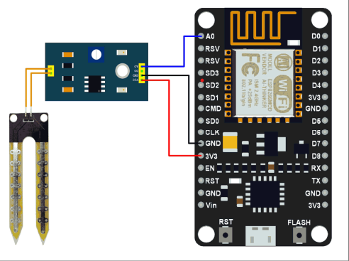
Block Diagram and Circuit Diagram

Slide 13
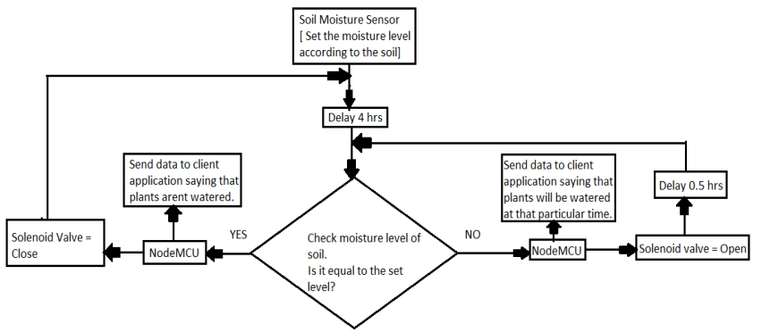
Flow Chart

Slide 14
Effective utilization of the Modern Tool & Cloud
We will be using MQTT box to connect the solenoid valve as well as the soil moisture sensor. MQTT is lightweight publish subscribe
based messaging protocol.
• It is quicker (faster) than other request-response based APIs like HTTP.
• It is developed on the base of TCP/IP protocol.
• It allows remote location devices to connect, subscribe, and publish etc. to a specific topic on the server with the help of
message broker.
• MQTT Broker/Message broker is a module in between the sender and the receiver. It is an element for message validation,
transformation and routing.
• The broker is responsible for distributing messages to the interested clients (subscribed clients) of their interested topic.

Slide 15
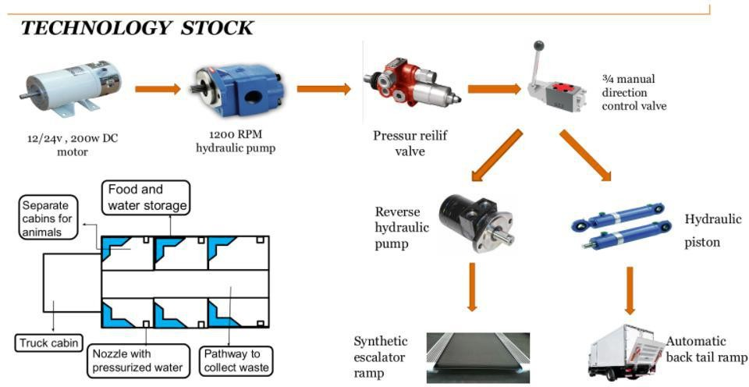
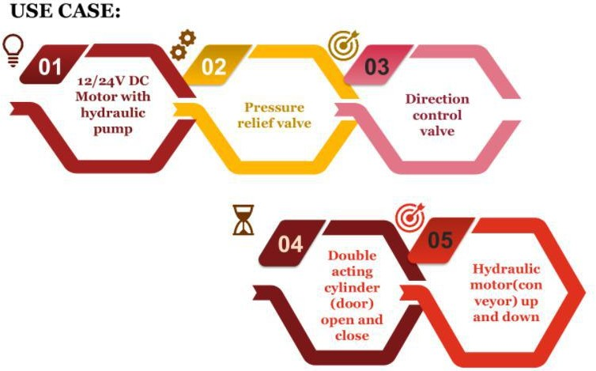
Technology stack & use case

Slide 16
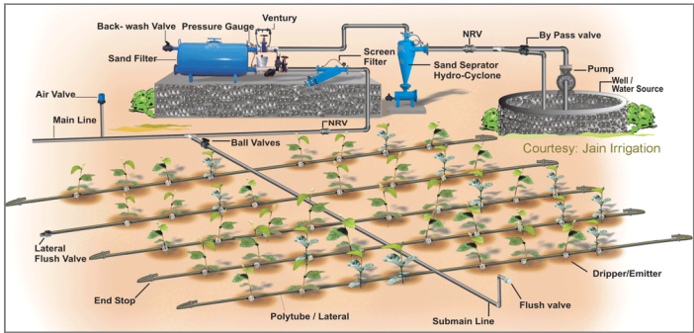
Sample Output

Slide 17
Analysis of Results & Discussions
ADVANTAGE :
Smart irrigation systems can optimize water levels based on things such as soil moisture and weather predictions. This is done with wireless moisture sensors that communicate with the smart irrigation controls and help inform the system whether or not the landscape is in need of water.
DISADVANTAGE :
smart watering system is a bit expensive. Depending on the size of your property, you will need more systems. Of course saving on water bills will lead to less cost. If you want to use this system for lawn watering, it's better to fix it under the ground before planting.

Slide 18
Cost Benefit Analysis (List of Components / Service Used)
(Budget)
S.No | Component Name | Specification (IC number or Range or Value) | Unit Cost | Total Cost
1. | node MCU | 14 | 999 | 999
2. | soil moisture sensor | 5 | 650 | 650
3. | voltage regulator | 5 | 349 | 349

Slide 19
References
https://www.instructables.com/id/IoT-Water-Control-and-Monitor-Using-NodeMCU-Cayenn/ https://www.electronicwings.com/nodemcu/nodemcu-mqtt-client-with-arduino-ide 3. https://www.electronicwings.com/nodemcu/soil-moisture-sensor-interfacing-with-nodemcu 4. https://www.omega.co.uk/prodinfo/solenoid-valve.html 5. https://tameson.com/solenoid-valve-types.html 6. http://www.circuitstoday.com/arduino-soil-moisture-sensor 7. https://www.nodemcu.com/index_en.html 8. https://www.instructables.com/id/IoT-Water-Control-and-Monitor-Using-NodeMCU-Cayenn/ 9. https://www.instructables.com/id/Interface-Moisture-Sensor-With-NodeMCU/ 10. https://www.jameco.com/Jameco/workshop/learning-center/voltage-regulator.html

